Slide 1
Chapter 5
Advanced Data Modeling

Slide 2
Chapter 5
Beginning – till page 180
Entity Clustering (pages 174-176)is not included in the course

Slide 3
The Extended Entity Relationship Model (EERM)
Enhanced entity relationship model
  Result of adding more semantic constructs to the original entity relationship (ER) model
  EER diagrams (EERDs) use the EER model

Slide 4
Entity Supertypes and Subtypes
Entity supertype
  Generic entity type related to one or more entity subtypes
  Contains common characteristics
Entity subtype
  Contains unique characteristics of each entity subtype
Criteria to determine usage
  There must be different, identifiable kinds of the entity in the user’s environment
  The different kinds of instances should each have one or more attributes that are unique to that kind of instance

Slide 5
Specialization Hierarchy (1 of 2)
Entity supertypes and subtypes are organized in a specialization hierarchy
  Depicts arrangement of higher-level entity supertypes and lower-level entity subtypes
  Relationships are described in terms of “is-a” relationships
  Subtype exists within the context of a supertype
  Every subtype has one supertype to which it is directly related
  Supertype can have many subtypes
A specialization hierarchy provides the means to:
  Support attribute inheritance
  Define a special supertype attribute known as the subtype discriminator
  Define disjoint or overlapping constraints and complete or partial constraints

Slide 6
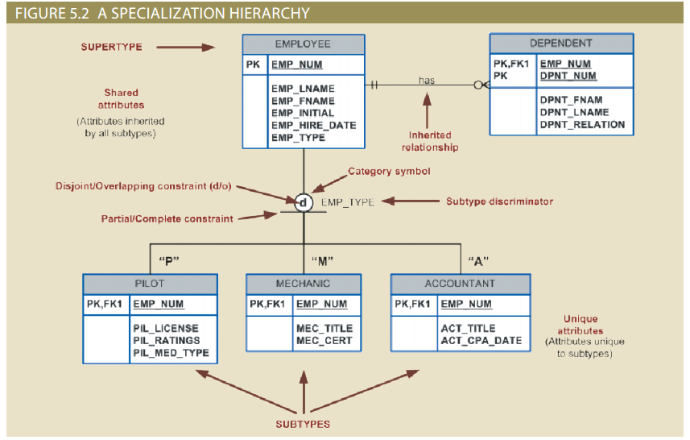
Specialization Hierarchy (2 of 2)

Slide 7
Inheritance (1 of 2)
Enables an entity subtype to inherit attributes and relationships of the supertype
  All entity subtypes inherit their primary key attribute from their supertype
  At the implementation level, supertype and its subtype(s) maintain a 1:1 relationship
  Entity subtypes inherit all relationships in which supertype entity participates
  Lower-level subtypes inherit all attributes and relationships from its upper-level supertypes

Slide 8
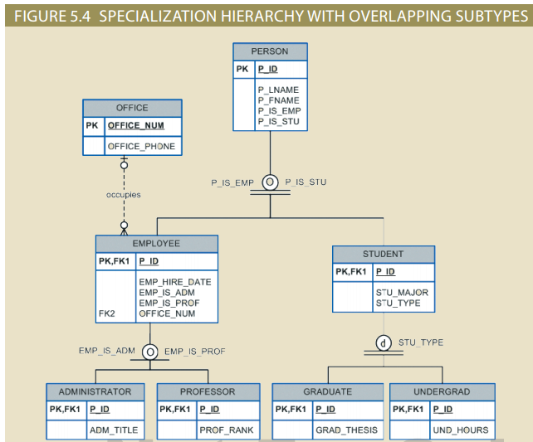
Inheritance (2 of 2)

Slide 9
Subtype Discriminator
Attribute in the supertype entity that determines to which entity subtype the supertype occurrence is related

Slide 10
Disjoint and Overlapping Constraints (1 of 2)
Disjoint subtypes: contain a unique subset of the supertype entity set
  Known as nonoverlapping subtypes
  Implementation is based on the value of the subtype discriminator attribute in the supertype
Overlapping subtypes: contain nonunique subsets of the supertype entity set
  Implementation requires the use of one discriminator attribute for each subtype (the values are true or false).

Slide 11
Disjoint and Overlapping Constraints (2 of 2)
TABLE 5.1: Discriminator Attributes with Overlapping Subtypes
Discriminator Attributes: Professor | Discriminator Attributes: Administrator | Comment
Y | N | The Employee is a member of the Professor subtype.
N | Y | The Employee is a member of the Administrator subtype.
Y | Y | The Employee is both a Professor and an Administrator.

Slide 12
Completeness Constraint (1 of 2)
Specifies whether each supertype occurrence must also be a member of at least one subtype
  Partial completeness: not every supertype occurrence is a member of a subtype
  Total completeness: every supertype occurrence must be a member of at least one subtypes

Slide 13
Completeness Constraint (2 of 2)
Table 5.2 | Specialization Hierarchy Constraint Scenarios
Type | Disjoint Constraint | Overlapping Constraint
Partial | Supertype has optional subtypes. Subtype discriminator can be null. Subtype sets are unique. | Supertype has optional subtypes. Subtype discriminators can be null. Subtype sets are not unique.
Total | Every supertype occurrence is a member of only one subtype. Subtype discriminator cannot be null. Subtype sets are unique. | Every supertype occurrence is a member of at least one subtype. Subtype discriminators cannot be null. Subtype sets are not unique.

Slide 14
Specialization and Generalization
Specialization
  Top-down process
  Identifies lower-level, more specific entity subtypes from a higher-level entity supertype
  Based on grouping unique characteristics and relationships of the subtypes
Generalization
  Bottom-up process
  Identifies a higher-level, more generic entity supertype from lower-level entity subtypes
  Based on grouping common characteristics and relationships of the subtypes

